Slide 1





Project overview
Title & Team details
Problem statement
Outline of Unique & innovative solution
Business model and commercialization potential
Proposed process flow / Architecture of implementation
Algorithm Details
One-page summary of the project

Slide 2


1. Title & Team Details
Title: CAl-Powered User & Entity Behaviour Analytics (UEBA) for Fraud Detection
Team Name: INNOVATOR
Name: Kritnandan
Name: Abhijit Dalai
Name: Khushi Tiwari
(Team Leader)
kritnandan22@iitk.ac.in
abhijitd22@iitk.ac.in
khushiti22@iitk.ac.in
7800060023
7008793484
7008032518

Slide 3
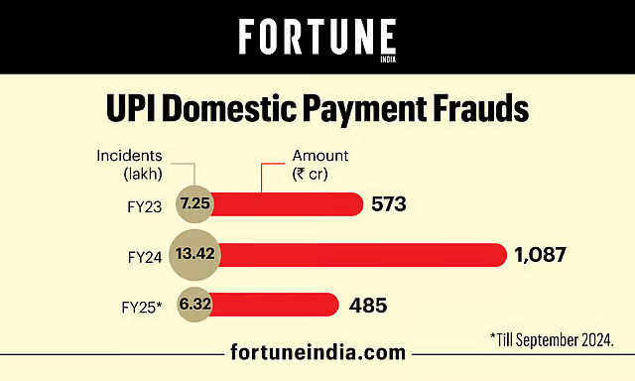

2. Problem Statement
With digital banking spanning internet, mobile apps, UPI, ATMs, and APIs, fraud risks are at an all-time high. In India alone, digital payment fraud reached ₹14.57 billion in FY 2023-24, with UPI scams causing losses of ₹485 crore across 6.3 lakh cases.
Evolving fraud schemes (Account Takeover, synthetic/new-account fraud, mule networks via recruited mules) evade static rules. Traditional rule-based systems often miss such fraud patterns and generate up to 95% false positives, degrading customer trust and experience. This highlights the urgent need for AI-powered behavioral analytics to detect fraud more accurately, with contextual and network awareness.
https://www.businesstoday.in/technology/news/story/digital-payment-frauds-surge-in-india-as-upi-transactions-skyrocket-rbi-report-431695-2024-06-01?utm
https://www.fortuneindia.com/macro/upi-frauds-63-lakh-cases-worth-485-cr-reported-in-fy25-so-far/119275
https://www.retailbankerinternational.com/comment/hidden-cost-of-aml-how-false-positives-hurt-banks-fintechs-customers/?cf-view
Sources:

Slide 4
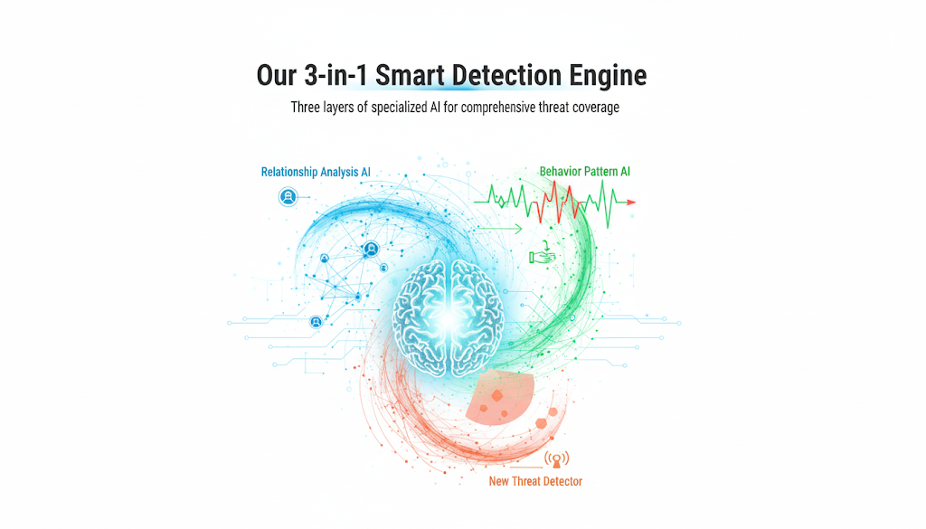
3. Outline of Unique & Innovative Solution
A 3-in-1 Smart Detection Engine
Self-Learning Decision Engine
Three layers of specialized AI for comprehensive threat coverage
The engine moves beyond static rules and learns from the outcome of every transaction, adapting its response to be more effective over time
Instead of a simple "block" or "approve" rule, our model learns the optimal action for each specific context, choosing between:
Links accounts and devices across 14,000+ transactions to reveal hidden network relationships, providing the context needed to detect coordinated fraud such as mule rings
Approve
Challenge
Block
Low-risk
Medium-risk
High-risk
Provides an unsupervised safety net, capable of identifying novel and emerging fraud typologies that supervised models have not been trained to recognize
Learns each customer’s unique digital rhythm to flag account takeovers by tracking recency, 1h/24h/7d transaction velocity, and deviations from usual spend
Projected Impact
30–40% reduction in false positives
50% faster fraud detection vs. legacy rules
Improved CX – fewer unnecessary blocks/challenges
Adaptive performance – gets smarter with every transaction

Slide 5
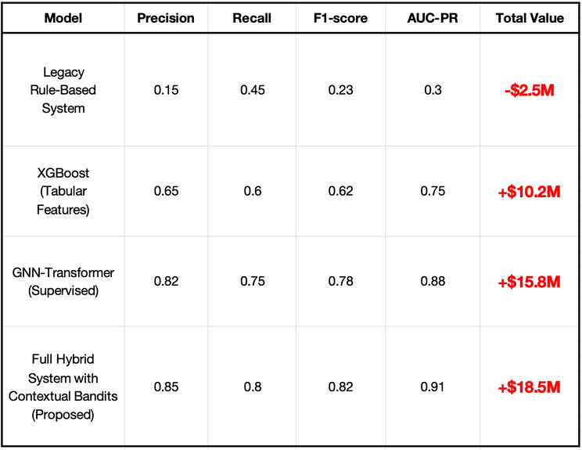

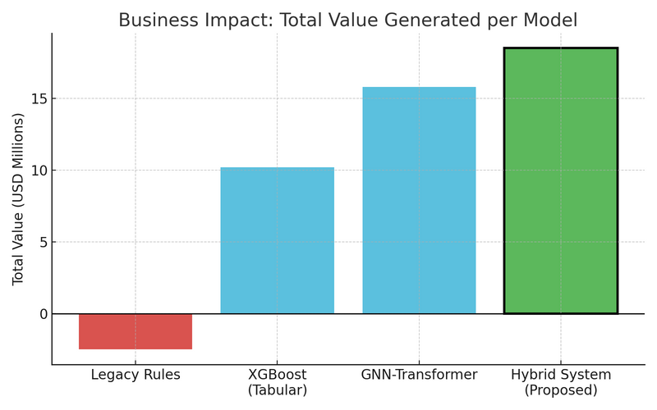
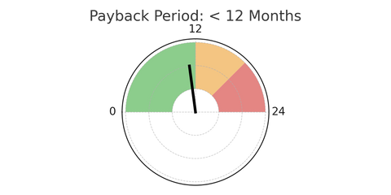

Performance Benchamarks against Baseline Models
4. Business model and commercialization potential
Market
Banks, NBFCs, fintechs, and payment service providers (PSPs) handling millions of daily transactions
Pain Points
Rising fraud losses, false positives hurting CX, and outdated rule engines failing to adapt
Solution
Hybrid AI engine + Reinforcement Learning
Scalability and Real-time Inference
Ultra-Low Latency: Optimized inference (<100 ms) using NVIDIA Triton servers for concurrent, high-throughput requests.
Model Optimization: Quantization & pruning to reduce compute cost without losing accuracy.
Fast Graph Operations: In-memory graph caching & efficient subgraph sampling for real-time GNN inference.
Continuous Monitoring: Real-time dashboards tracking Precision, Recall, F1-score, fraud loss rates & false positives.
Drift Detection: Contextual Bandit rewards signal concept drift, triggering model retraining when needed.
Explainability (XAI): SHAP-based feature attribution + graph visualizations to meet regulatory requirements and accelerate investigations.
Human-in-the-Loop: AI handles routine cases; complex alerts routed to analysts with full context for faster resolution.
Closed Feedback Loop: Analyst outcomes retrain models & update RL policy — making the system continuously smarter.
Revenue
SaaS + Enterprise
Licenses + Services
Accuracy alone is misleading, choosing the right metrics:
Precision-Recall & AUC-PR: Balance fraud detection vs. false positives
Recall @ Low FPR (<1%): Maximize fraud catch rate without hurting CX
F1-Score: Optimal trade-off between precision and recall
Recall
F1-score
Precision
AUC-PR
Key Performance Indicators

Slide 6
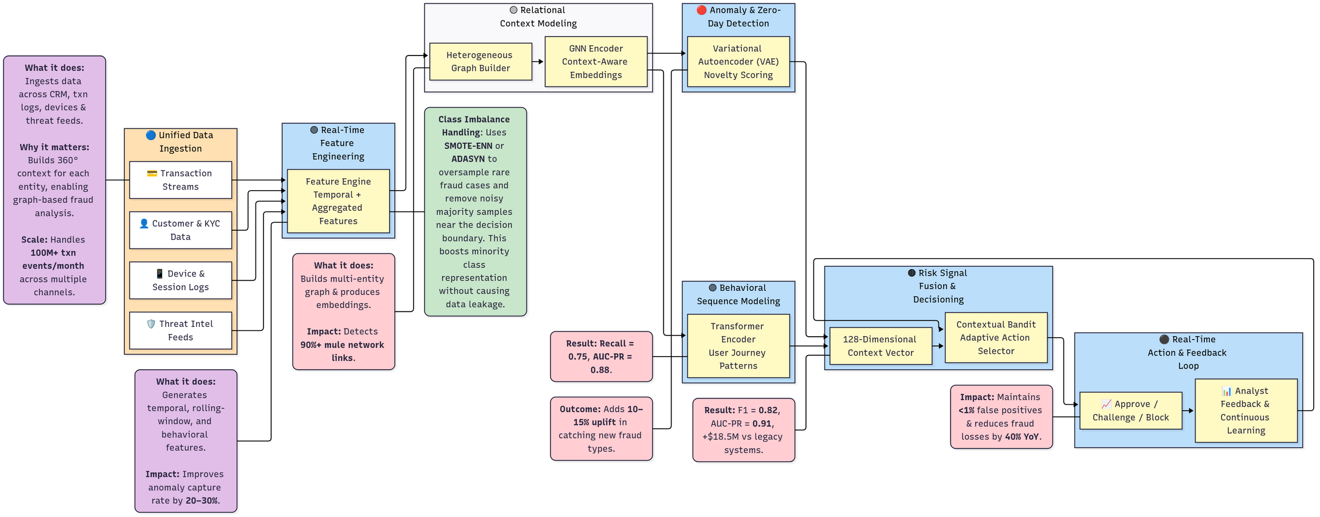
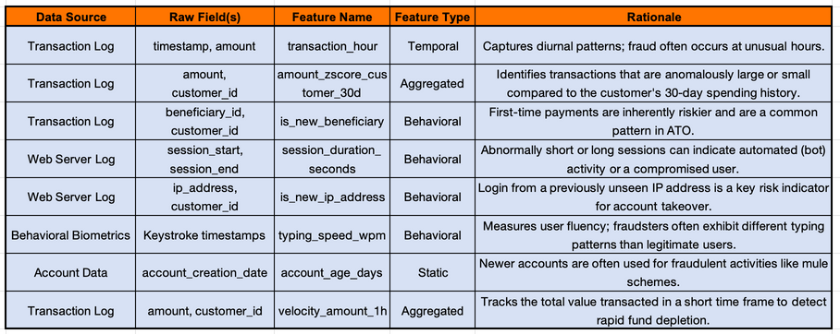
5. Proposed process flow / Architecture of implementation
Data Sources and Feature Engineering Strategy
SMOTE (Synthetic Minority Over-sampling Technique), creates new, synthetic fraud examples by interpolating between existing fraud instances in the feature space.
ADASYN (Adaptive Synthetic Sampling) is a refinement of SMOTE that generates more synthetic samples for minority class examples that are harder to learn (i.e., those closer to the decision boundary), adaptively focusing the model on the most difficult cases.

Slide 7








Time-window aggregations: rolling mean/median/sum/count, std/volatility (1h/24h/7d/30d)
Velocity & burst metrics, Recency/Frequency/Monetary (RFM), scaling & normalization
6. Algorithm Details
Node Types: User, Account, Transaction, Device, IP Address, Merchant.
How Reinforcement Learning works here:
Context: 128-D risk vector (GNN + Transformer + VAE + features).
Action: Selects Approve / 2FA / Block.
Reward: Positive if fraud is blocked, negative if missed or customer unnecessarily challenged.
Learning: Continously learns optimal actions by balancing exploration vs. exploitation to maximize reward.
Edge Types: Capture relationships like (User–owns–Account), (Account–sent–Transaction), (Transaction–initiated_from–IP).
Feature Engine
Learns to choose the best action (Approve / 2FA / Block) for each transaction context using a reward-based system.
Heterogeneous Graph Builder
Features: Node attributes (e.g., account_age, avg_txn_amount_30d) and edge attributes (e.g., txn amount, timestamp) enrich graph context.
Contextual Bandit
Algorithm
Performs k-hop message passing, where each node aggregates information from its neighbors up to k layers deep (e.g., user → account → device → merchant).
Flags zero-day or unseen frauds when reconstruction error is high (e.g., beyond 99th percentile of normal validation data).
Graph Neural Networks (GNNs)
Variational Autoencoder (VAE)
Learns a probabilistic latent space of normal transactions by minimizing reconstruction loss + KL divergence.
Transformer Encoder
Generates context-aware embeddings capturing both local and multi-hop structural context
Learns temporal behavior patterns (e.g., normal login → purchase → transfer flow) and flags deviations like account takeover or bot-driven fraud.
Uses Relational Graph Convolutional Network (R-GCN) to handle multiple edge types and Graph Attention Network (GAT) attention to weigh neighbor importance.
Takes GNN embeddings and processes user activity as a time-ordered sequence with self-attention.

Slide 8
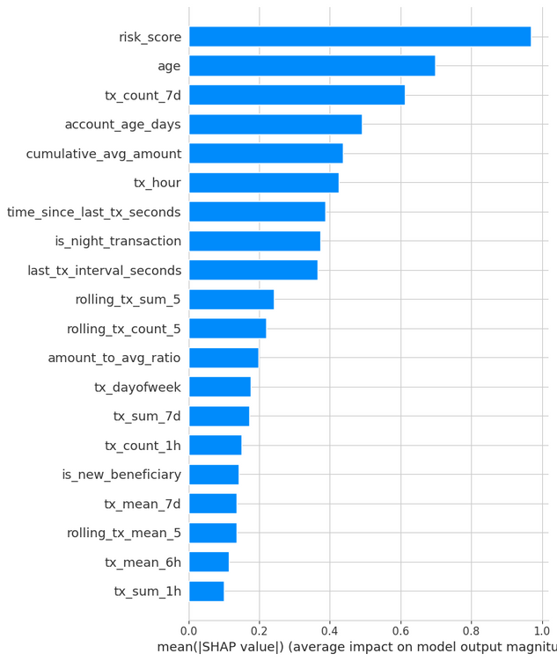
7. One-page summary of the project
Our Solution: A 3-in-1 Smart Detection Engine powered by AI and Self-Learning Decisioning:
The Challenge: Digital payment fraud is rising, while legacy rule-based systems suffer from high false positives (up to 95%), poor adaptability, and weak detection of advanced threats.
Relationship Analysis (GNNs): Unmasks hidden fraud rings via entity networks.
Behavior Pattern AI (Transformers): Detects anomalies in user transaction sequences.
New Threat Detection (VAE): Identifies zero-day and unseen fraud patterns.
Adaptive Decisioning (Contextual Bandits): Learns optimal actions (Approve, Challenge, Block) for continuous improvement.
Architecture & Flow:
Real-time ingestion of 100M+ events/month.
Rich feature engineering with graph embeddings & behavioral signals
Parallel AI inference producing a unified context vector.
Continuous learning loop through adaptive decisioning.
Performance Metrics: Recall, Precision, F1-score and AUC-PR
Projected Impact
Customer Trust:
Less friction, improved experience.
Feature Importance in Fraud Detection Prediction
Efficiency:
30–40% fewer false positives, 50% faster detection.
Business Value:
+$18.5M ROI, SaaS-ready, <12 months payback.
Conclusion: A shift from reactive fraud detection to proactive, intelligent prevention—delivering robust, adaptive, and scalable defense for Bank of Baroda’s digital ecosystem.

